Slide 1




PROXIMAL PLANT & CROP SENSORS
Lecture 6: Listening to the Plant
AGE 418
Dr. Kadeghe Fue

Slide 2



Lecture Roadmap
Canopy Sensors
Machine Vision
Reflectance (GreenSeeker)
AI & Cameras
Fluorescence
Weed Detection
Thermal (Water Stress)
See & Spray Tech
Leaf Wetness

Slide 3
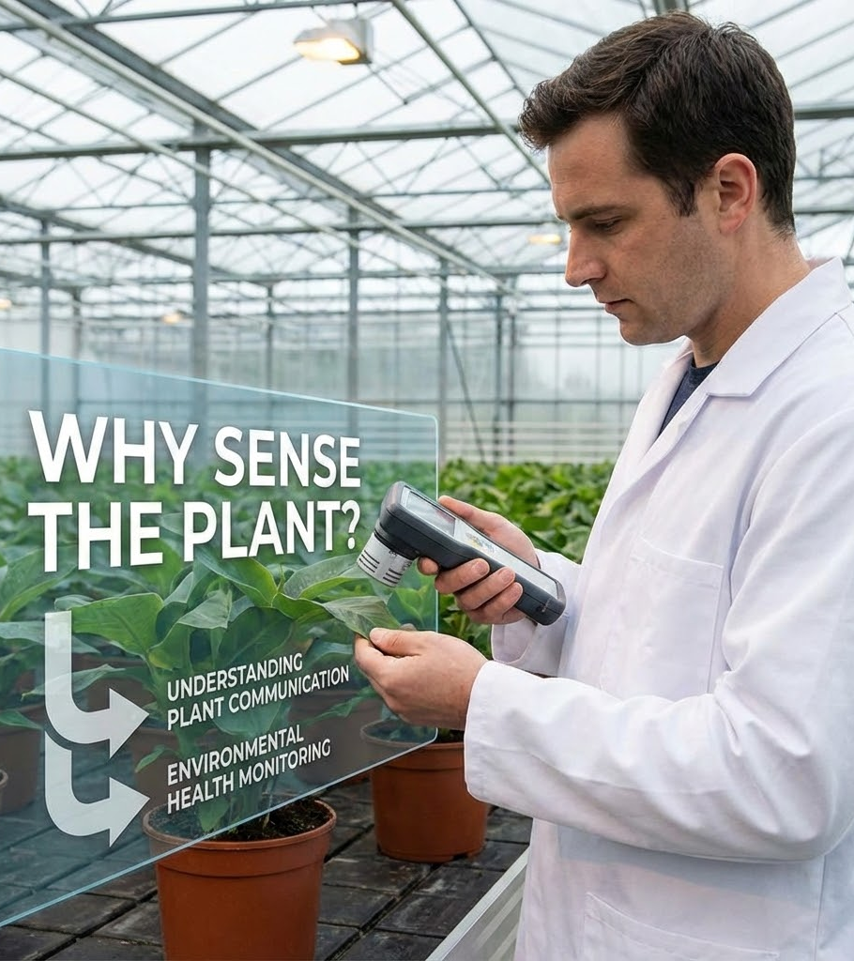
Why Sense the Plant?
Soil data is important, but the Plant is the ultimate indicator of yield.
The plant integrates all environmental factors:
Soil Moisture
Nutrient Availability
Pest Pressure
Weather Conditions

Slide 4


Active Canopy Sensors
Unlike satellites (Passive), Active Sensors carry their own light source.
Mechanism: Emit bursts of Red and NIR light.
Measure: The light reflected back from the leaves.
Benefit: Works day or night, independent of cloud cover.

Slide 5
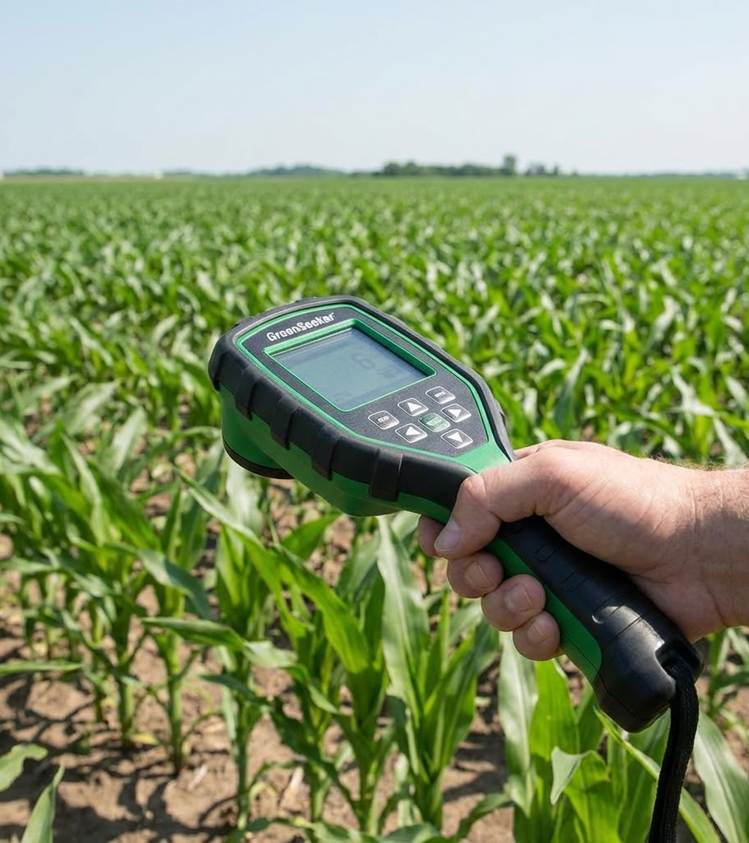
The GreenSeeker
The industry standard for nitrogen management.
Output: Calculates NDVI in real-time (on the tractor).
Application: Connected directly to the sprayer controller.
Result: "On-the-Go" Variable Rate Application (VRA) of Nitrogen.

Slide 6

Real-Time VRA
The sensor acts as the "Eye" and the Sprayer as the "Hand".
1. Sense
2. Calculate
3. Apply
Sensor detects low biomass (Low NDVI).
Algorithm determines N-requirement.
Nozzle opens to apply fertilizer.
Lag Time: < 1 second.

Slide 7

Chlorophyll Fluorescence
Measuring "Plant Heartbeat"
When a plant is stressed, photosynthesis slows down. The unused energy is re-emitted as red light (Fluorescence).
Advantage: Detects stress before the leaves turn yellow (Pre-visual).
Use: Early drought or disease detection.

Slide 8


Thermal Sensing
Canopy Temperature = Water Status
Healthy Plant
Stressed Plant
Stomata Open -> Transpiration -> Cooling Effect.
Stomata Close -> No Transpiration -> Heating Up.
Plant is cooler than air.
Plant is hotter than air.

Slide 9
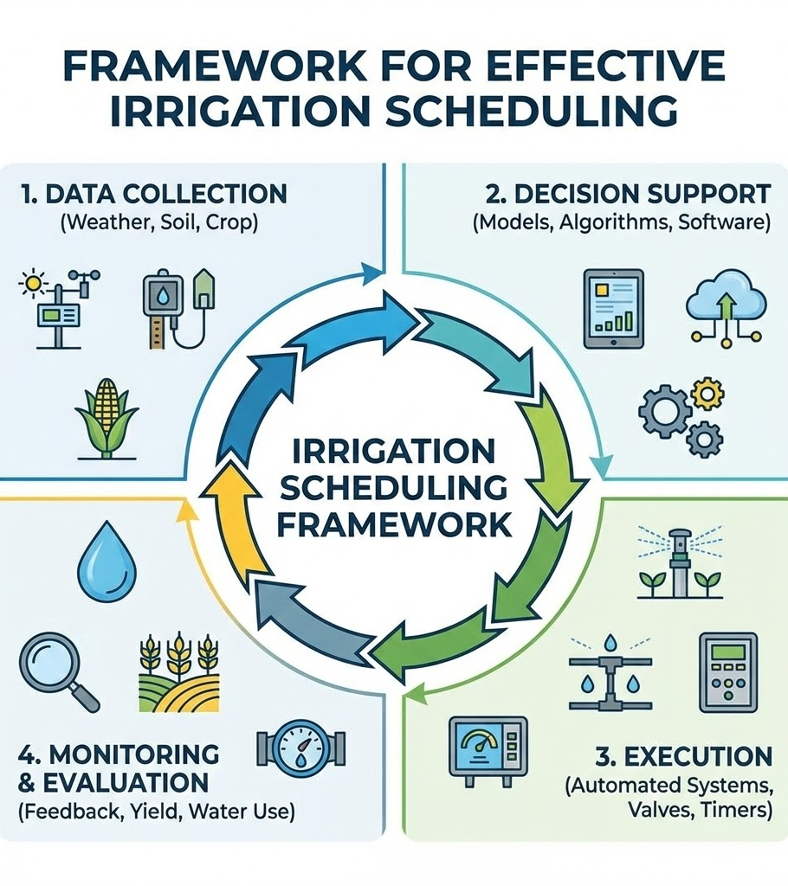
Irrigation Scheduling
Using the Crop Water Stress Index (CWSI).
Thermal cameras mounted on pivots or tractors scan the field. If Canopy Temp > Threshold, the irrigation system triggers automatically.
Result: Precision Irrigation.

Slide 10

Machine Vision & AI
Teaching computers to "See" like humans.
Sensors: High-resolution RGB cameras.
Brain: Artificial Neural Networks (Deep Learning).
Task: Identify objects (Weeds, Fruits, Pests) in milliseconds.

Slide 11
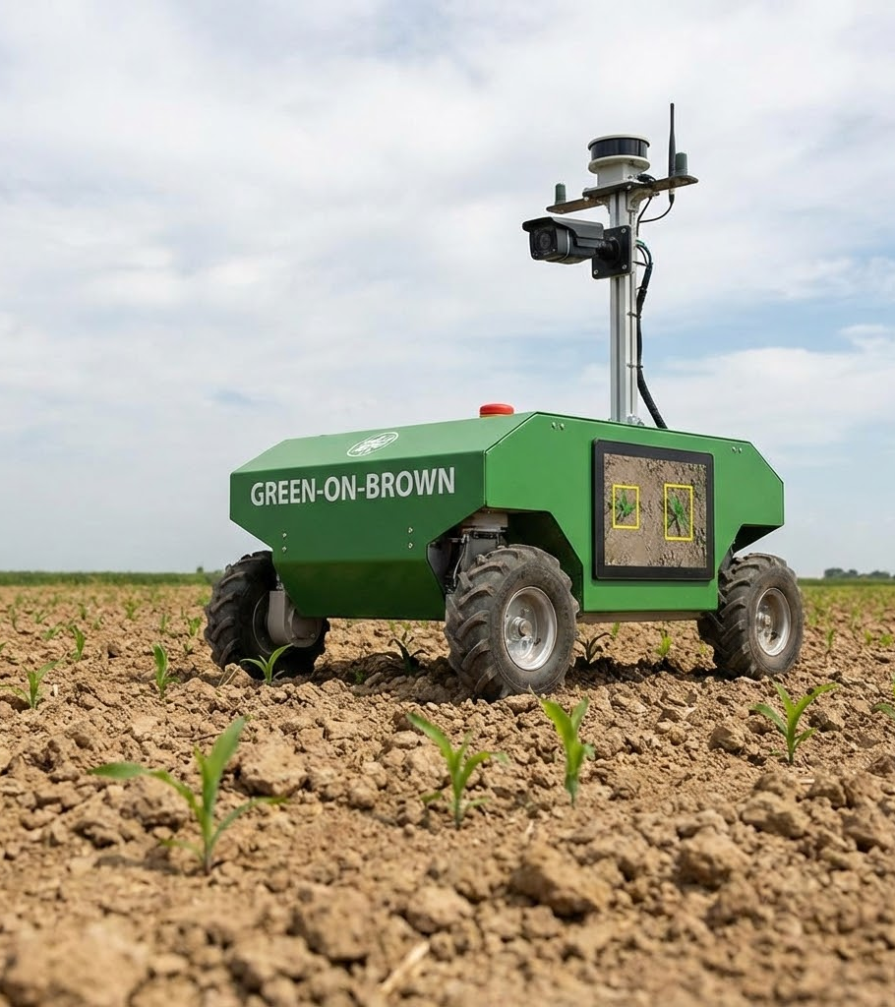
Weed Detection
Green-on-Brown: Detecting green plants on bare soil. (Easy).
Green-on-Green: Detecting a weed inside a crop. (Hard).
AI models are trained to recognize leaf shapes and textures to differentiate a Weed from a Crop.

Slide 12
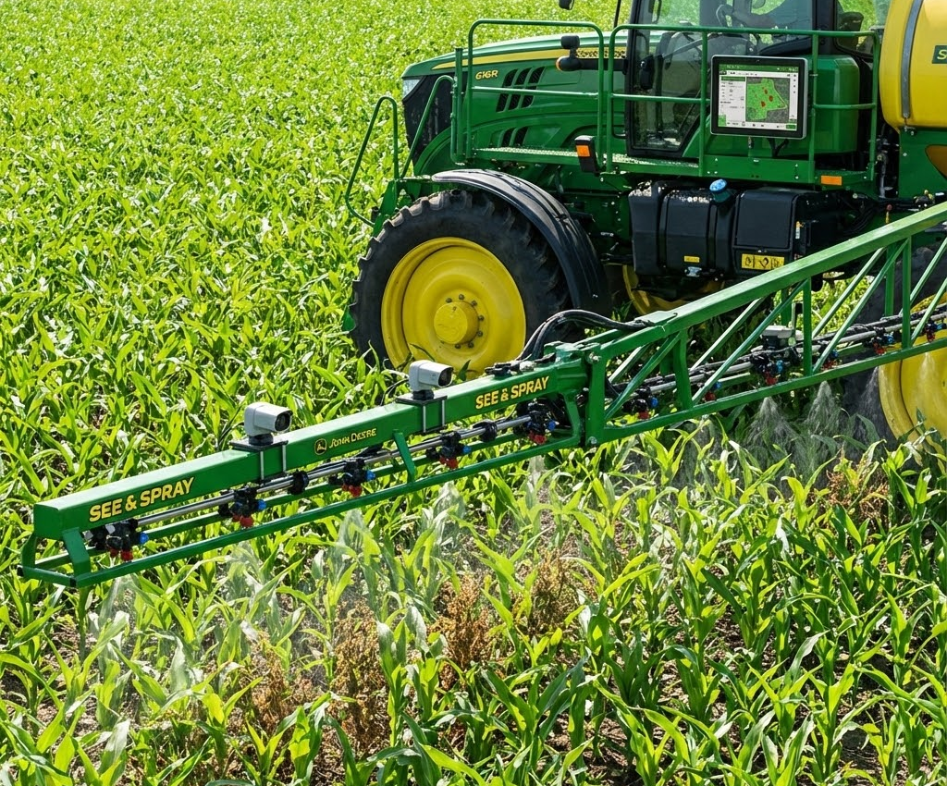
See & Spray Technology
The sprayer nozzles are individually controlled by cameras.
Traditional: Broadcast spray entire field.
Smart: Spray only the weed.
Impact: Reduces herbicide use by up to 90%.

Slide 13
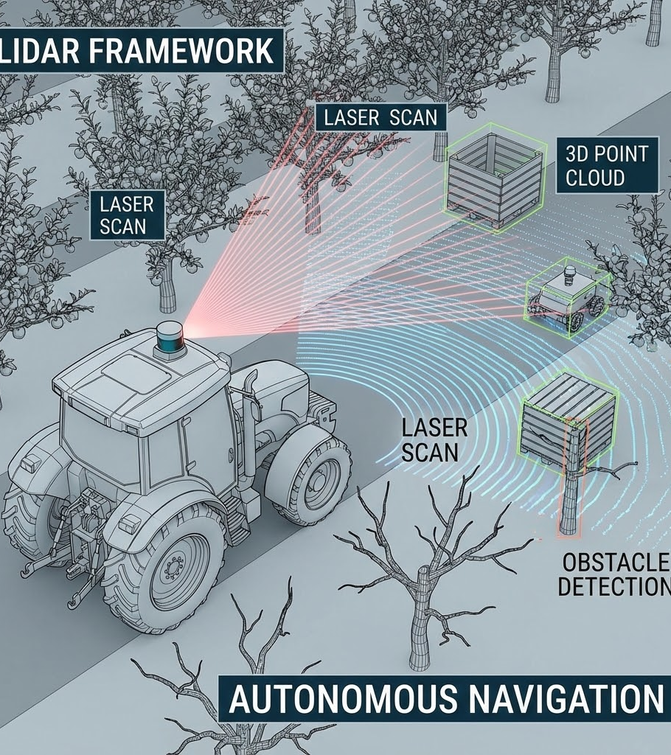
LiDAR in Agriculture
Light Detection and Ranging.
Lasers measure distance to create a 3D point cloud of the plant.
Biomass: Measures accurate height and volume.
Orchards: Measures tree canopy volume to adjust pesticide dosage (Variable Rate Airblast).

Slide 14
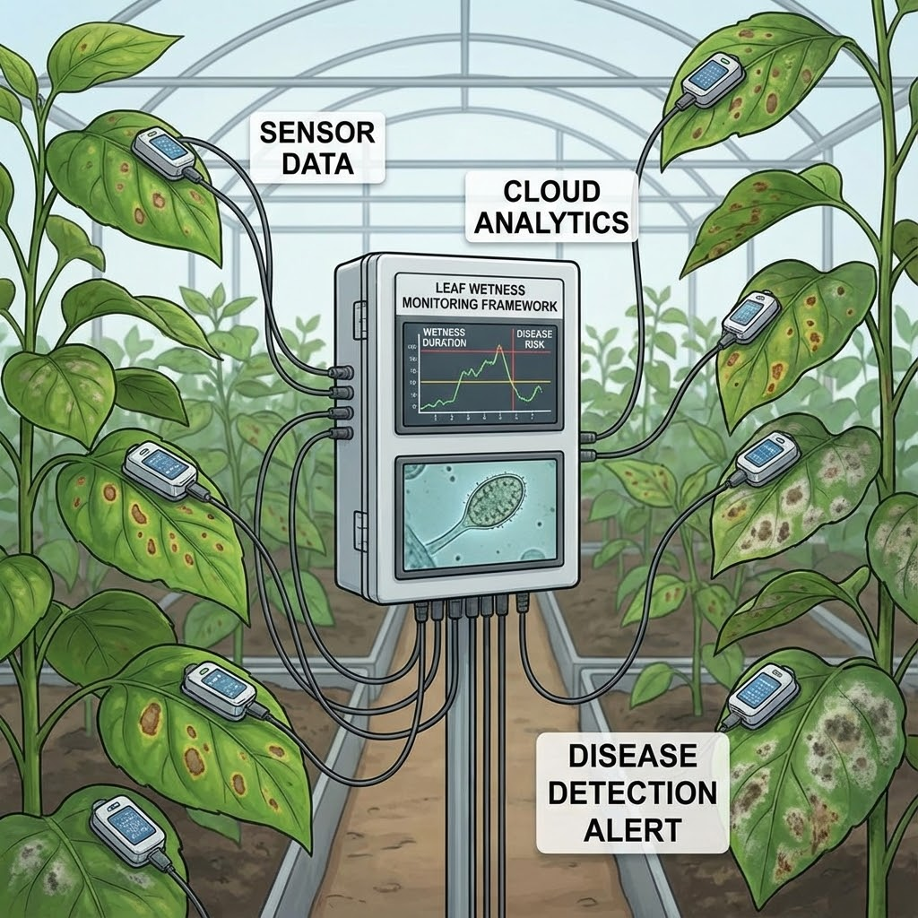
Leaf Wetness Sensors
Disease Forecasting.
Fungal diseases (e.g., Late Blight) need moisture to germinate.
Sensor: Artificial leaf surface that detects condensation.
Model: If Leaf is wet > 10 hours @ 20°C -> Warning Alert!
Action: Spray fungicide preventatively.

Slide 15

Disease Detection
Using Hyperspectral Cameras.
Visual Symptoms
Spectral Changes
Early Warning
Yellow spots (Chlorosis), Brown spots (Necrosis).
Pathogens destroy cell structure, changing NIR reflectance before spots appear.
Allows for "Spot Spraying" of fungicides instead of treating the whole field.

Slide 16

Integration: IoT
Sensors are now "Smart" and connected.
Edge Computing: Cameras process weed data locally (on the tractor) for instant spray decisions.
Cloud Computing: Leaf wetness data is sent to the cloud to run disease models.
Dashboard: Farmer gets an alert on their phone.

Slide 17
Lecture Summary
Active Sensors
Imaging
Robotics
GreenSeeker uses active light to measure NDVI day or night for N-management.
Thermal cameras detect water stress; Machine Vision detects weeds and diseases.
"See & Spray" technology reduces chemical use by up to 90%.
Next Class: Lecture 7 - Data Collection & IoT

Slide 18

Questions?
Dr. Kadeghe Fue | AGE 418
Sokoine University of Agriculture

